Slide 1
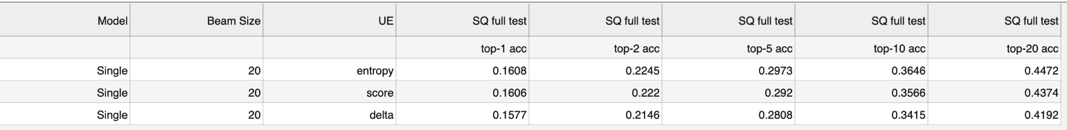
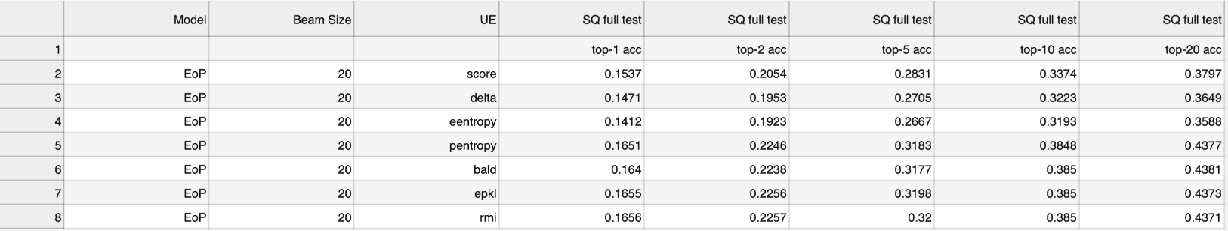
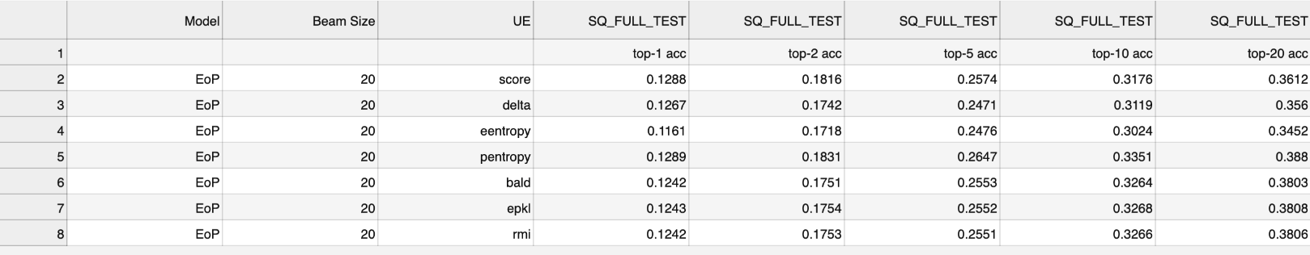
SQ full test beam size 20
Dropout 0.1
Dropout 0.01

Slide 2
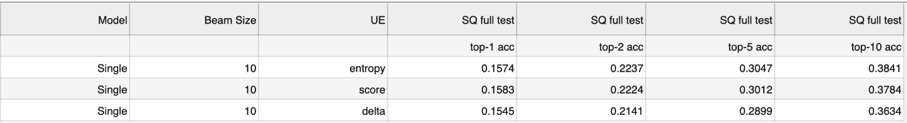
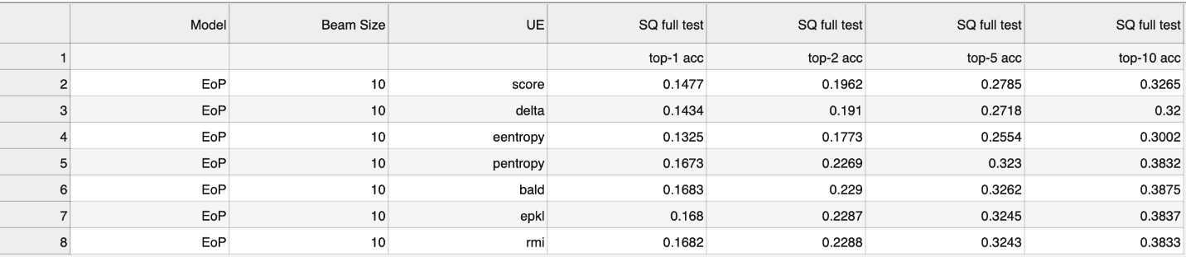
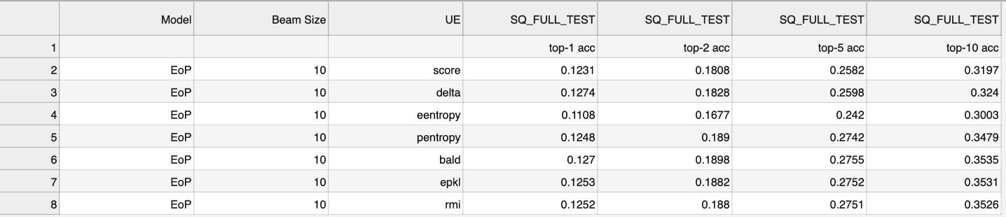
SQ full test beam size 10
Dropout 0.1
Dropout 0.01

Slide 3
Main point For SQ IN GRAPH:
Expected entropy – worse behavior on high rejection rates
Predictive entropy, EPKL, BALD stable and very similar
Best performance (especially for low rejection rates) for Delta, Maxprob and Eentropy. (All of them perform worse on high rejection rates)
MC-DROPOUT
Dropout rate 0.01

Slide 4
Main point For SQ FULL TEST:
Expected entropy – worse behavior on high rejection rates
Predictive entropy, EPKL, BALD stable and very similar
Best performance (especially for low rejection rates) for Delta, Maxprob and Eentropy. (All of them perform worse on high rejection rates)
Difference from IN GRAPH – more stable
MC-DROPOUT
Dropout rate 0.01

Slide 5
Main point For SQ FULL TEST:
Expected entropy – worse behavior on high rejection rates
Predictive entropy, EPKL, BALD stable and very similar, but gain is small.
Best performance by Delta, Maxprob
Eentropy perform very well at low rejection rates
MC-DROPOUT
Dropout rate 0.01

Slide 6
Main point For SQ FULL TEST:
Expected entropy – worse behavior on high rejection rates
Predictive entropy, EPKL, BALD stable and very similar, but gain is small.
Best performance by Delta, Maxprob
Eentropy perform very well at low rejection rates
Difference from full – better quality.
MC-DROPOUT
Dropout rate 0.01

Slide 7
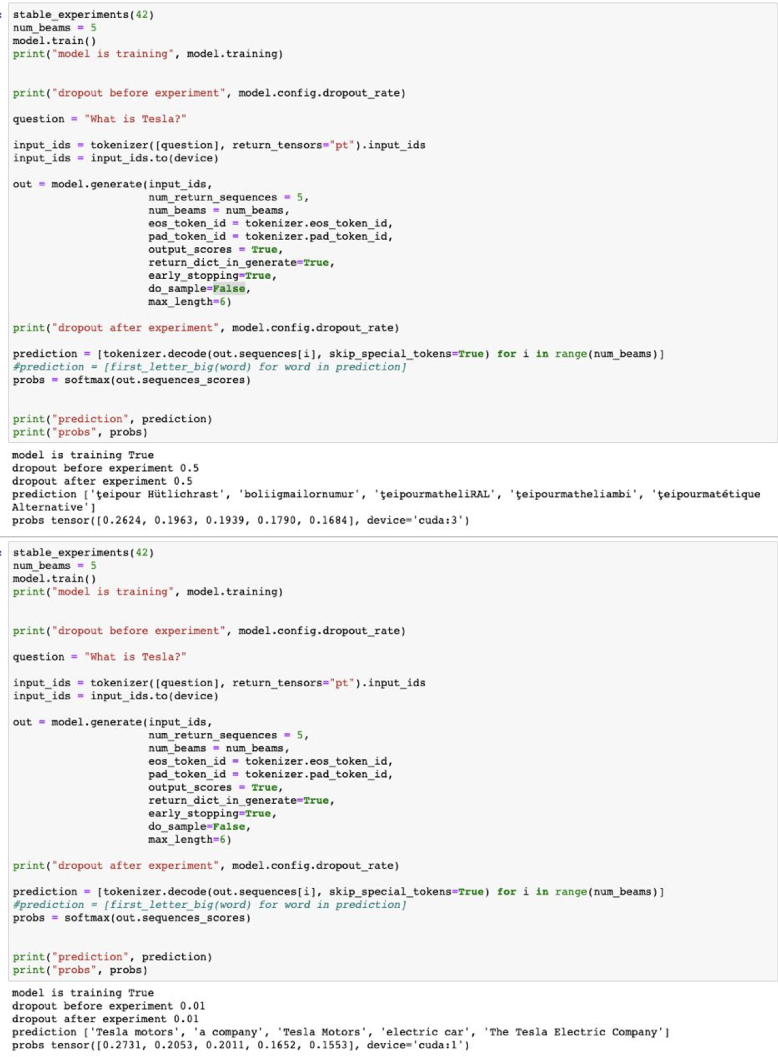
Dropout rate issues

Slide 8
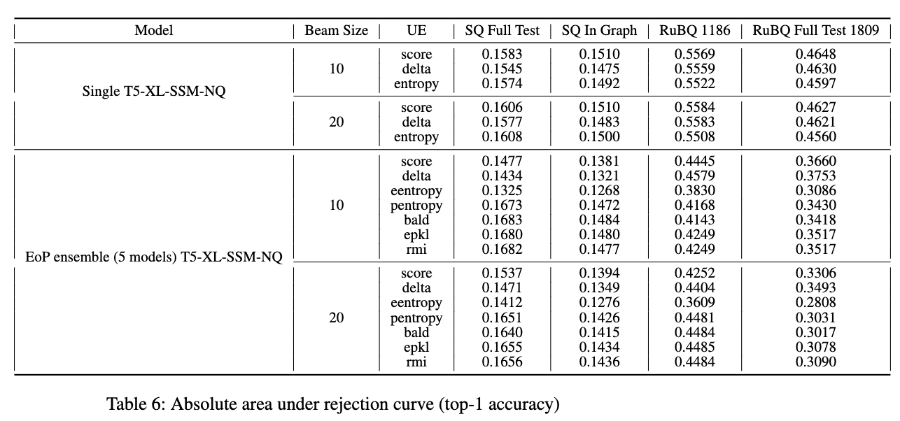

Slide 9
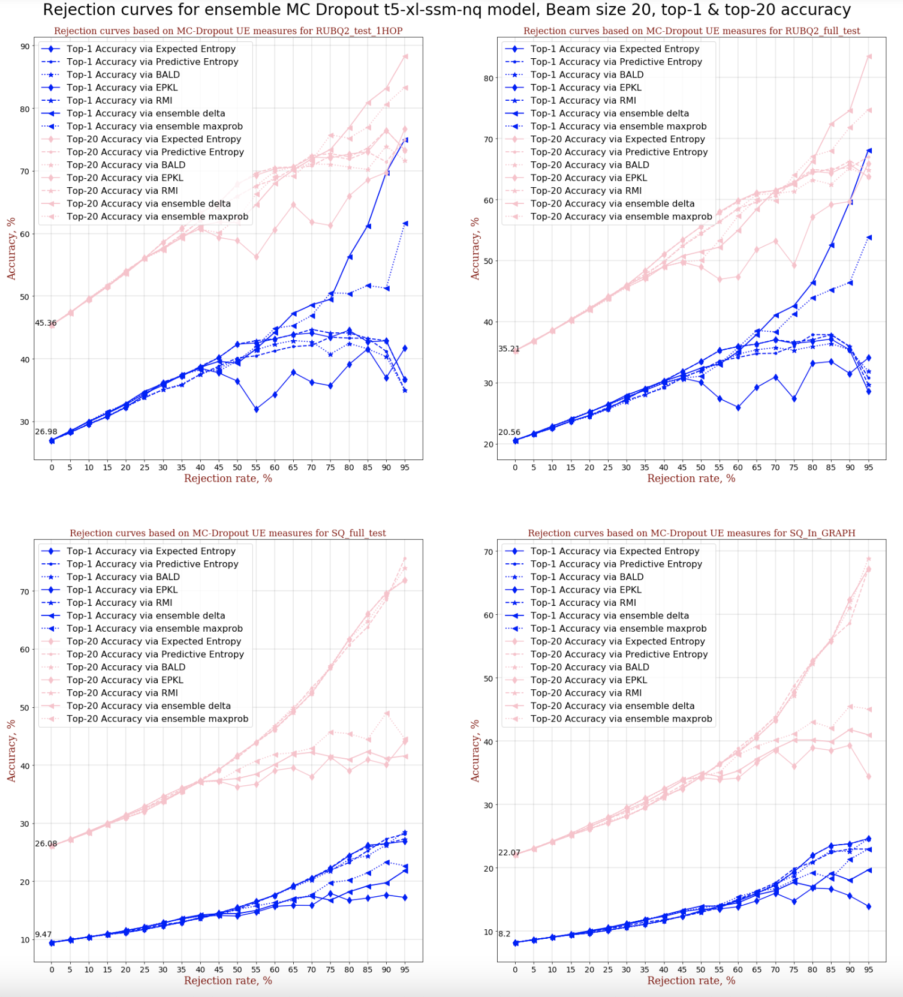
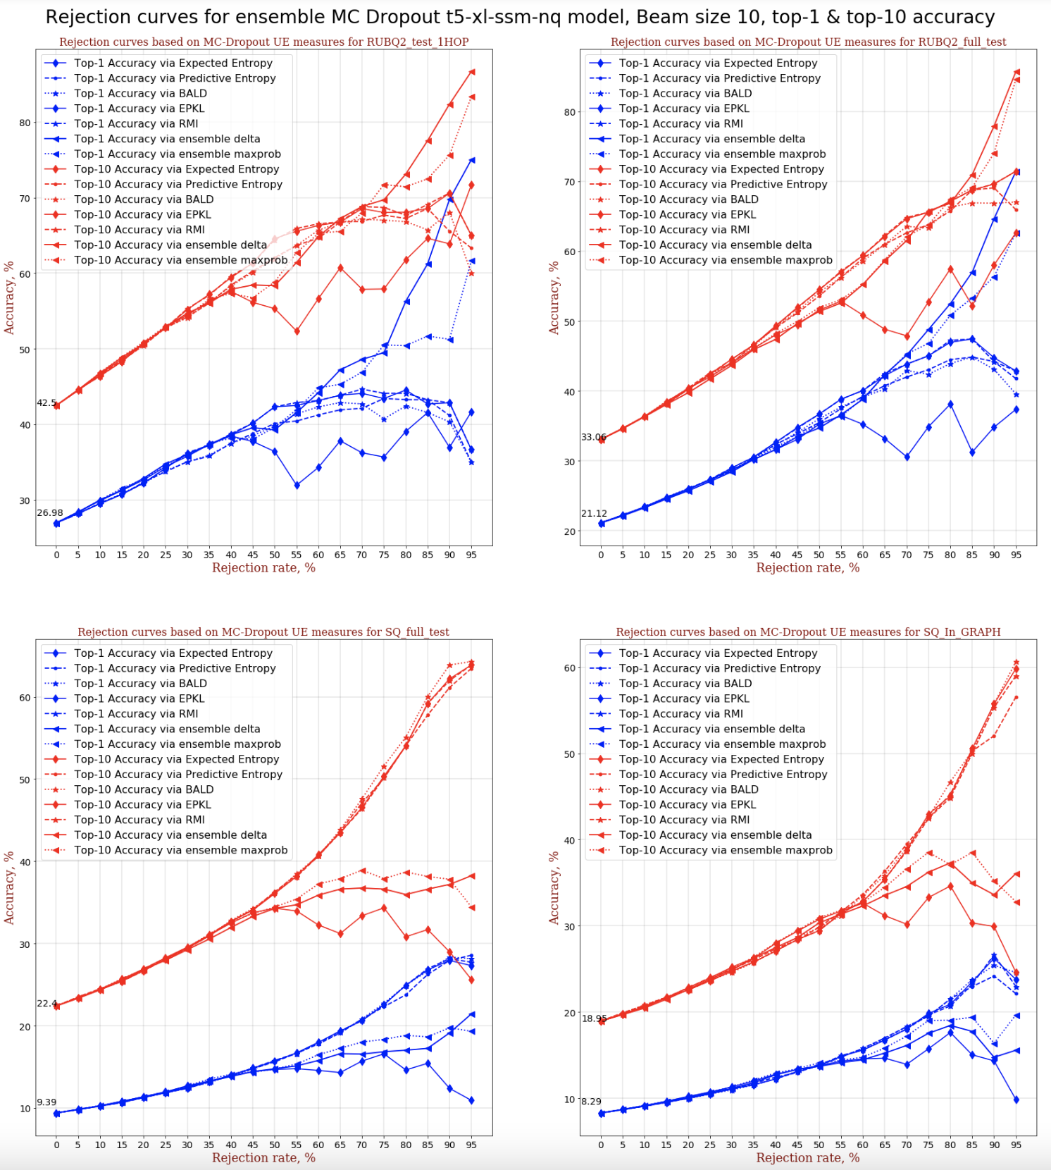

Slide 10
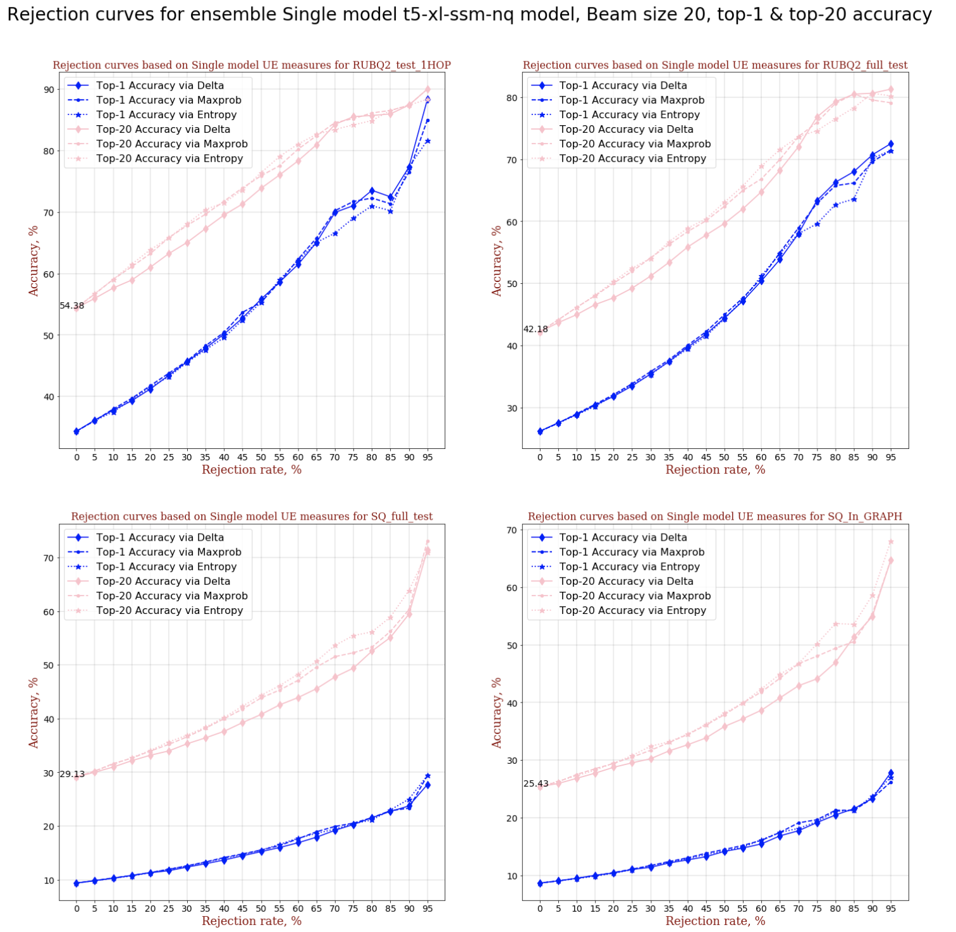
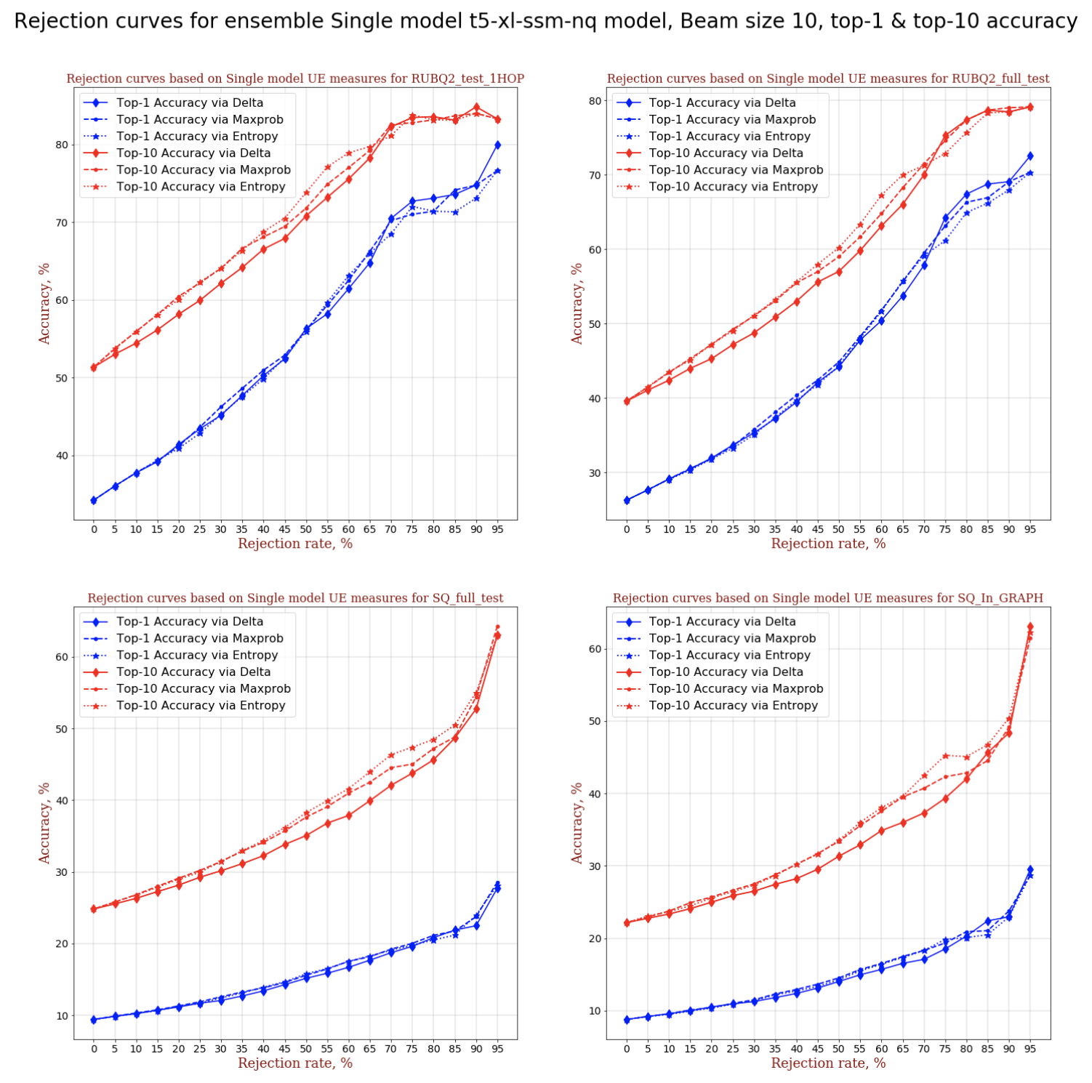

Slide 11
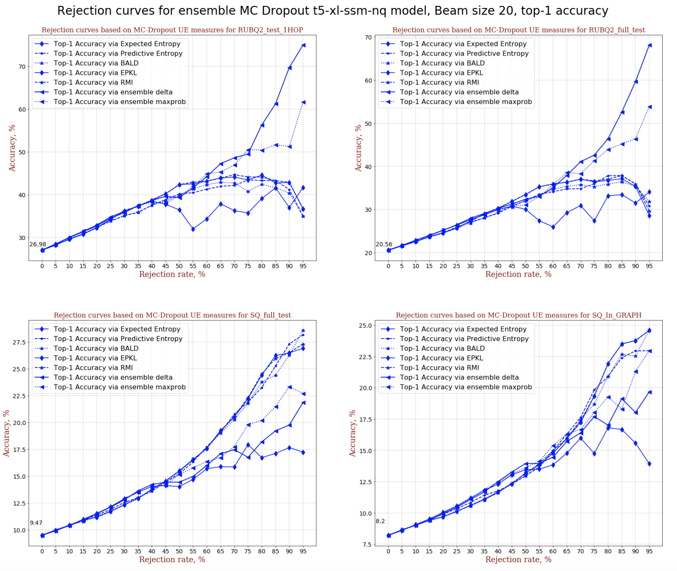

Slide 12
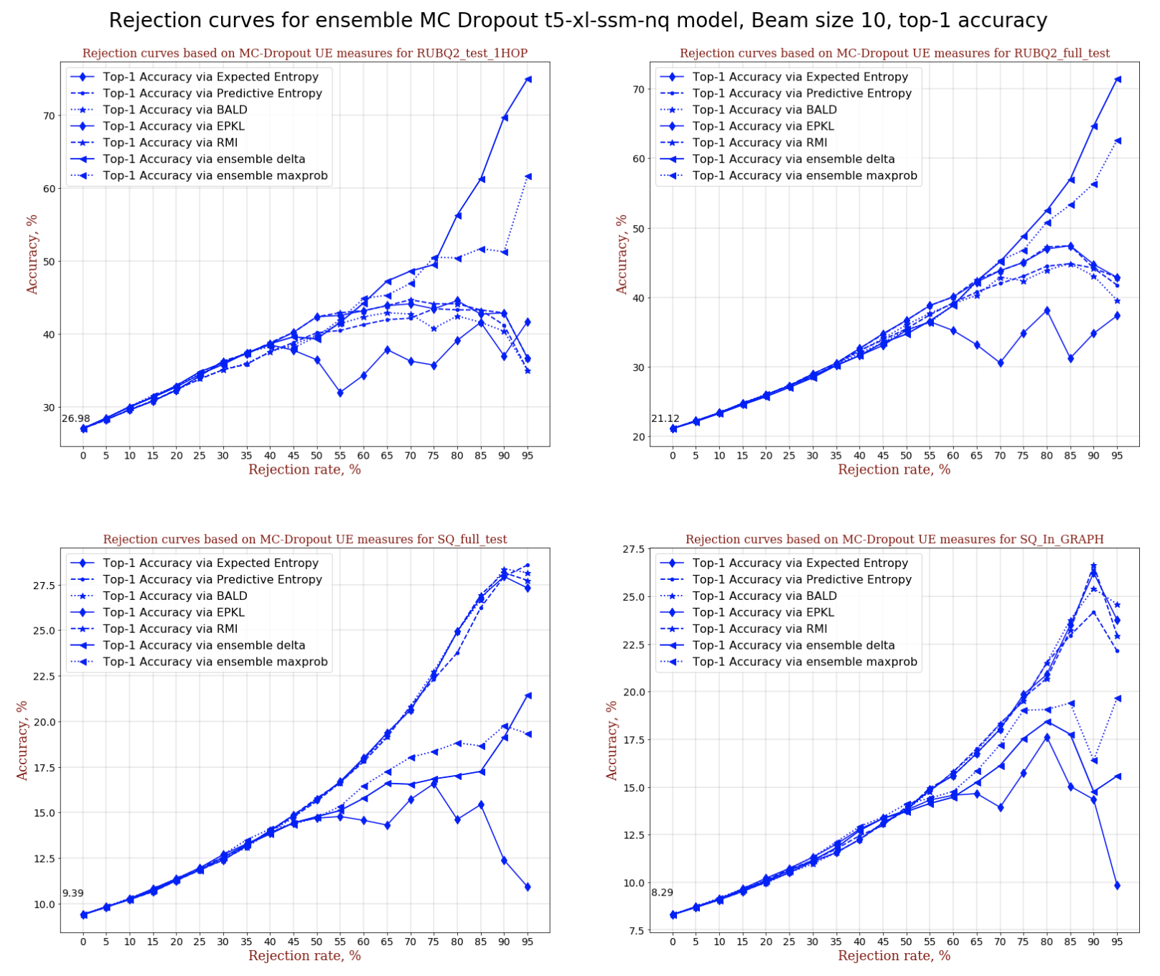

Slide 13
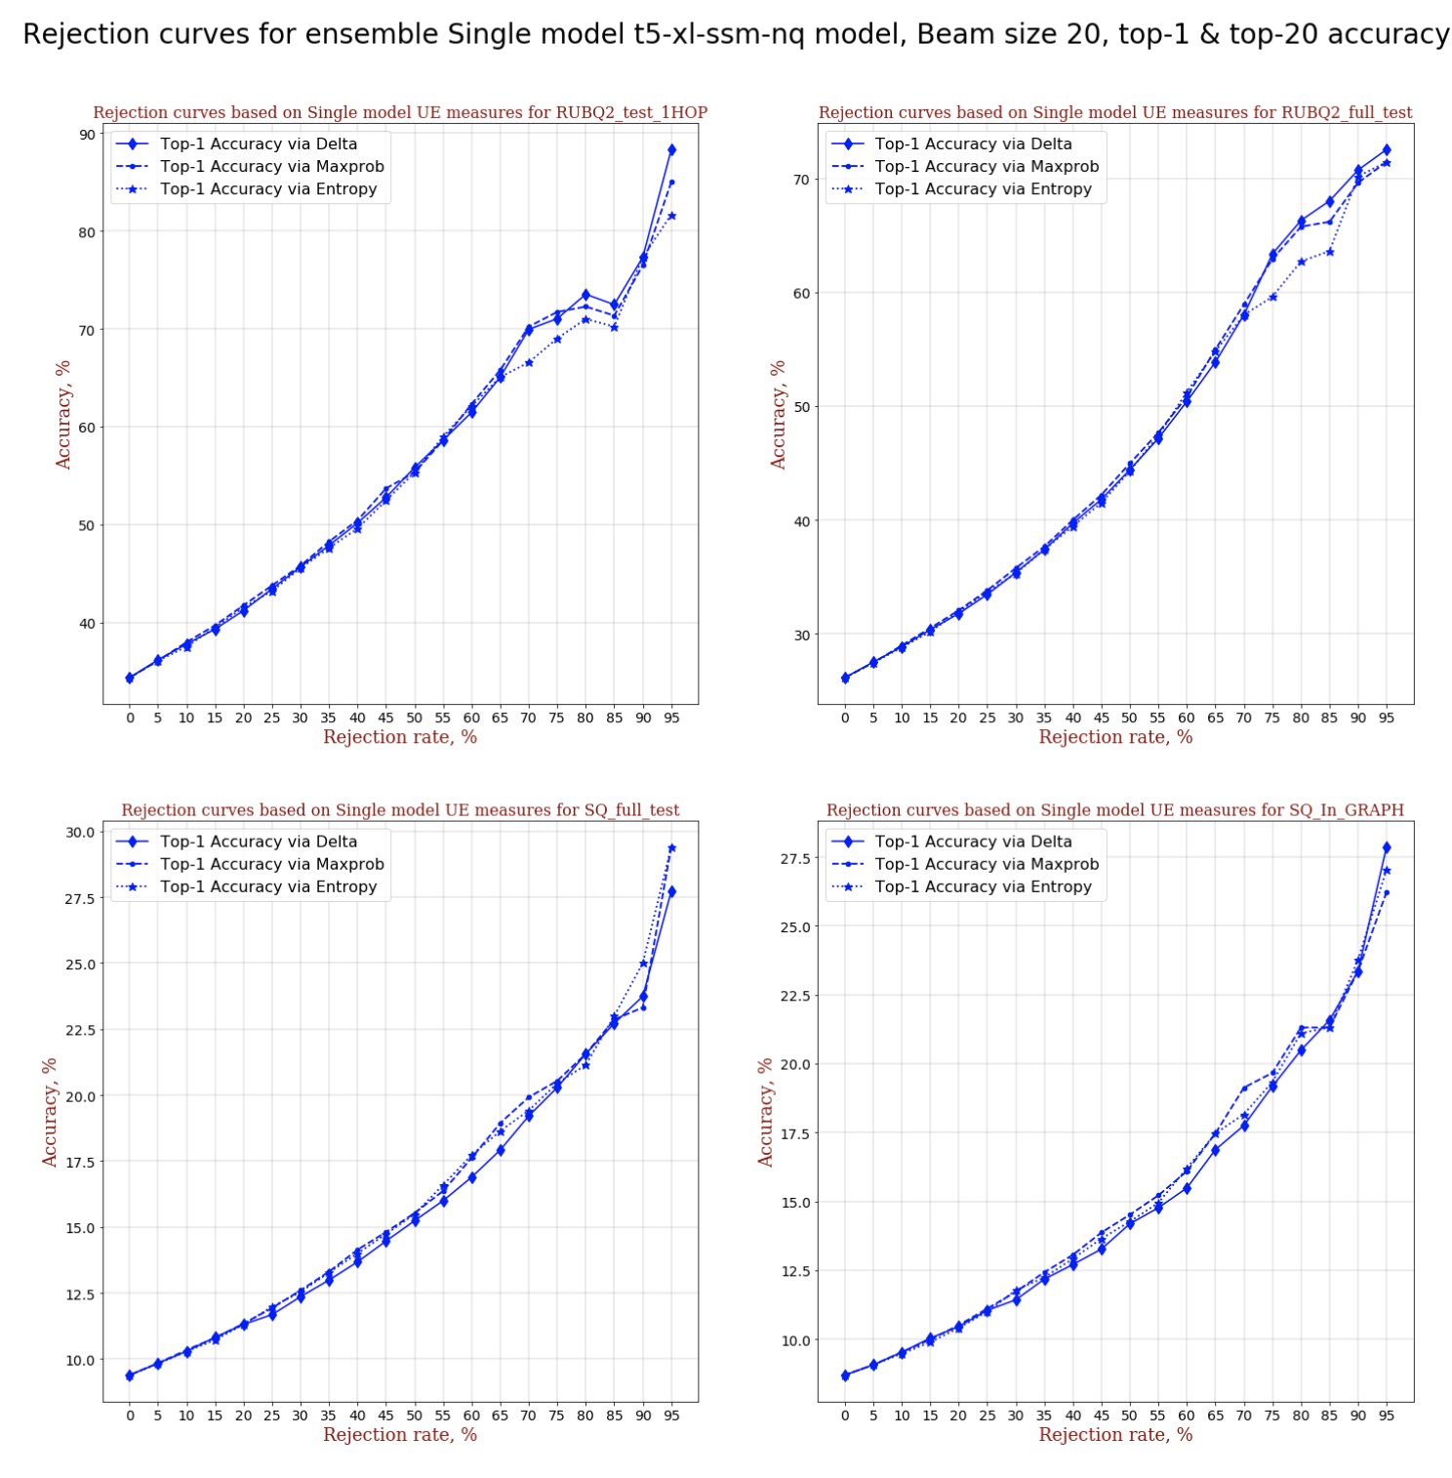

Slide 14
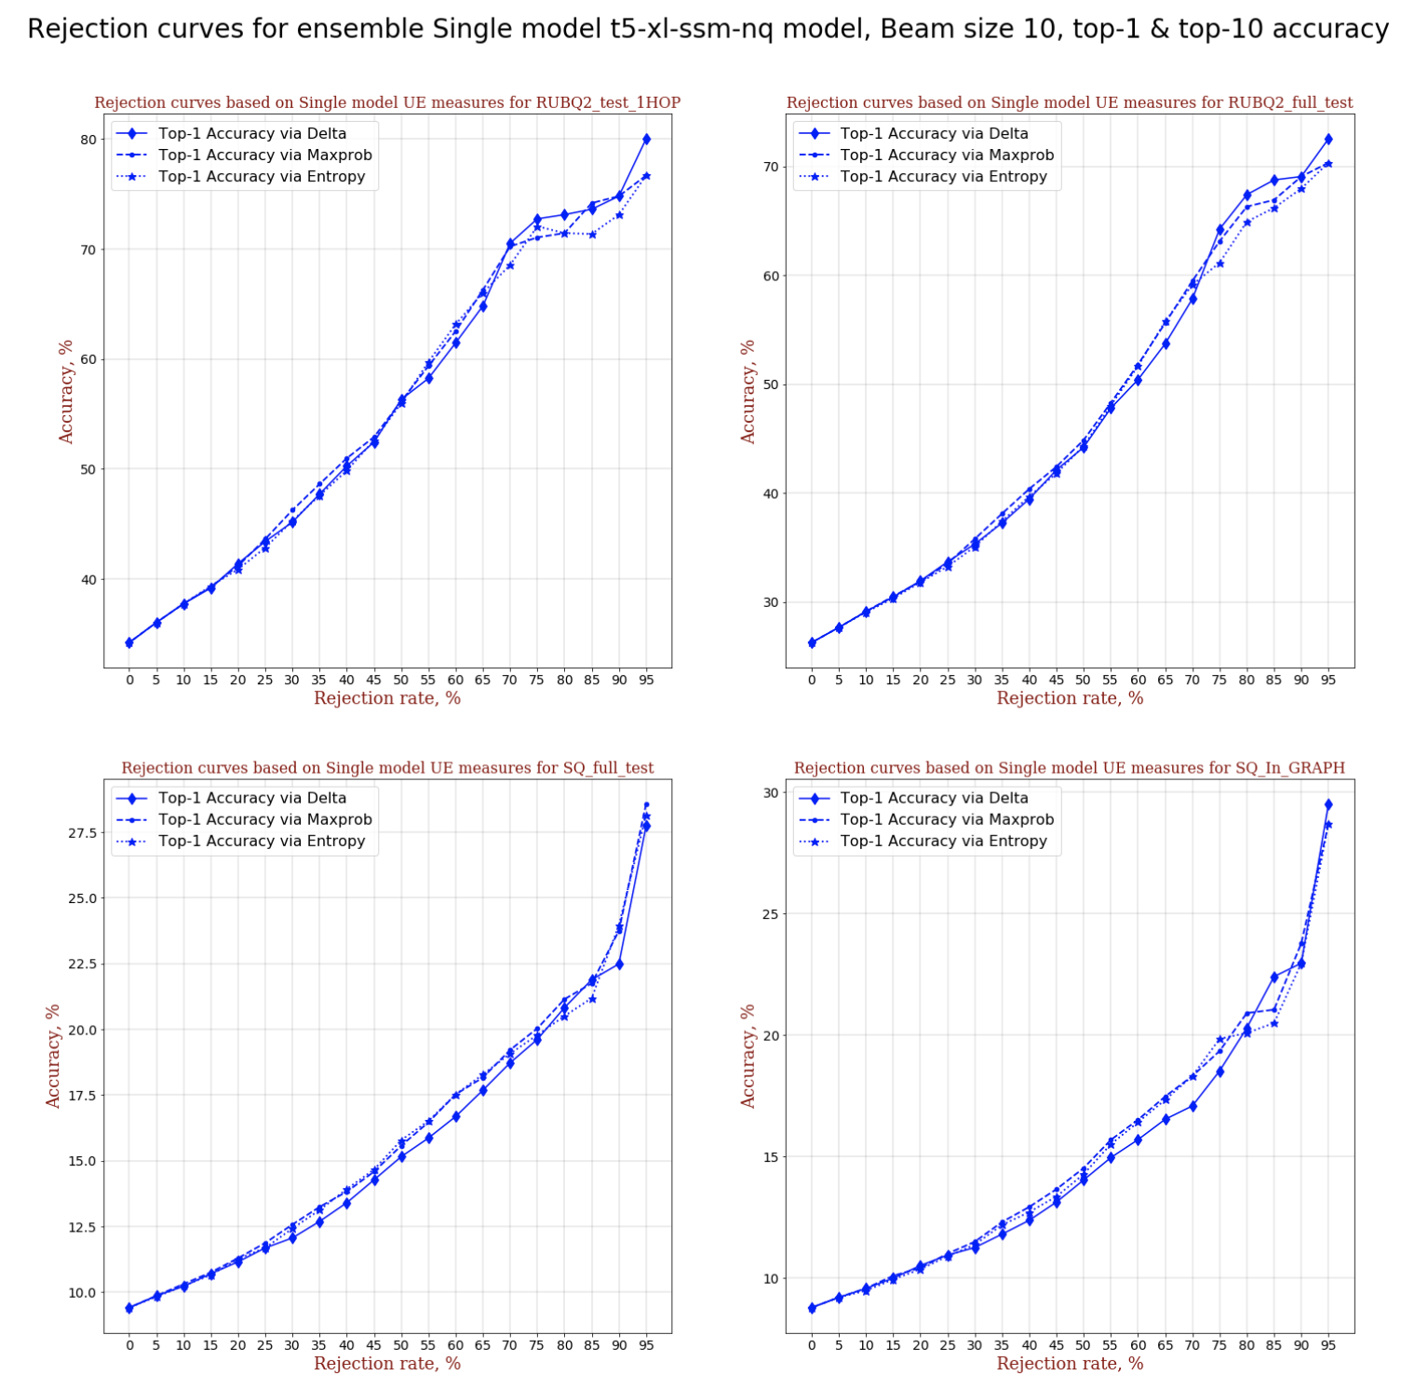

Slide 15
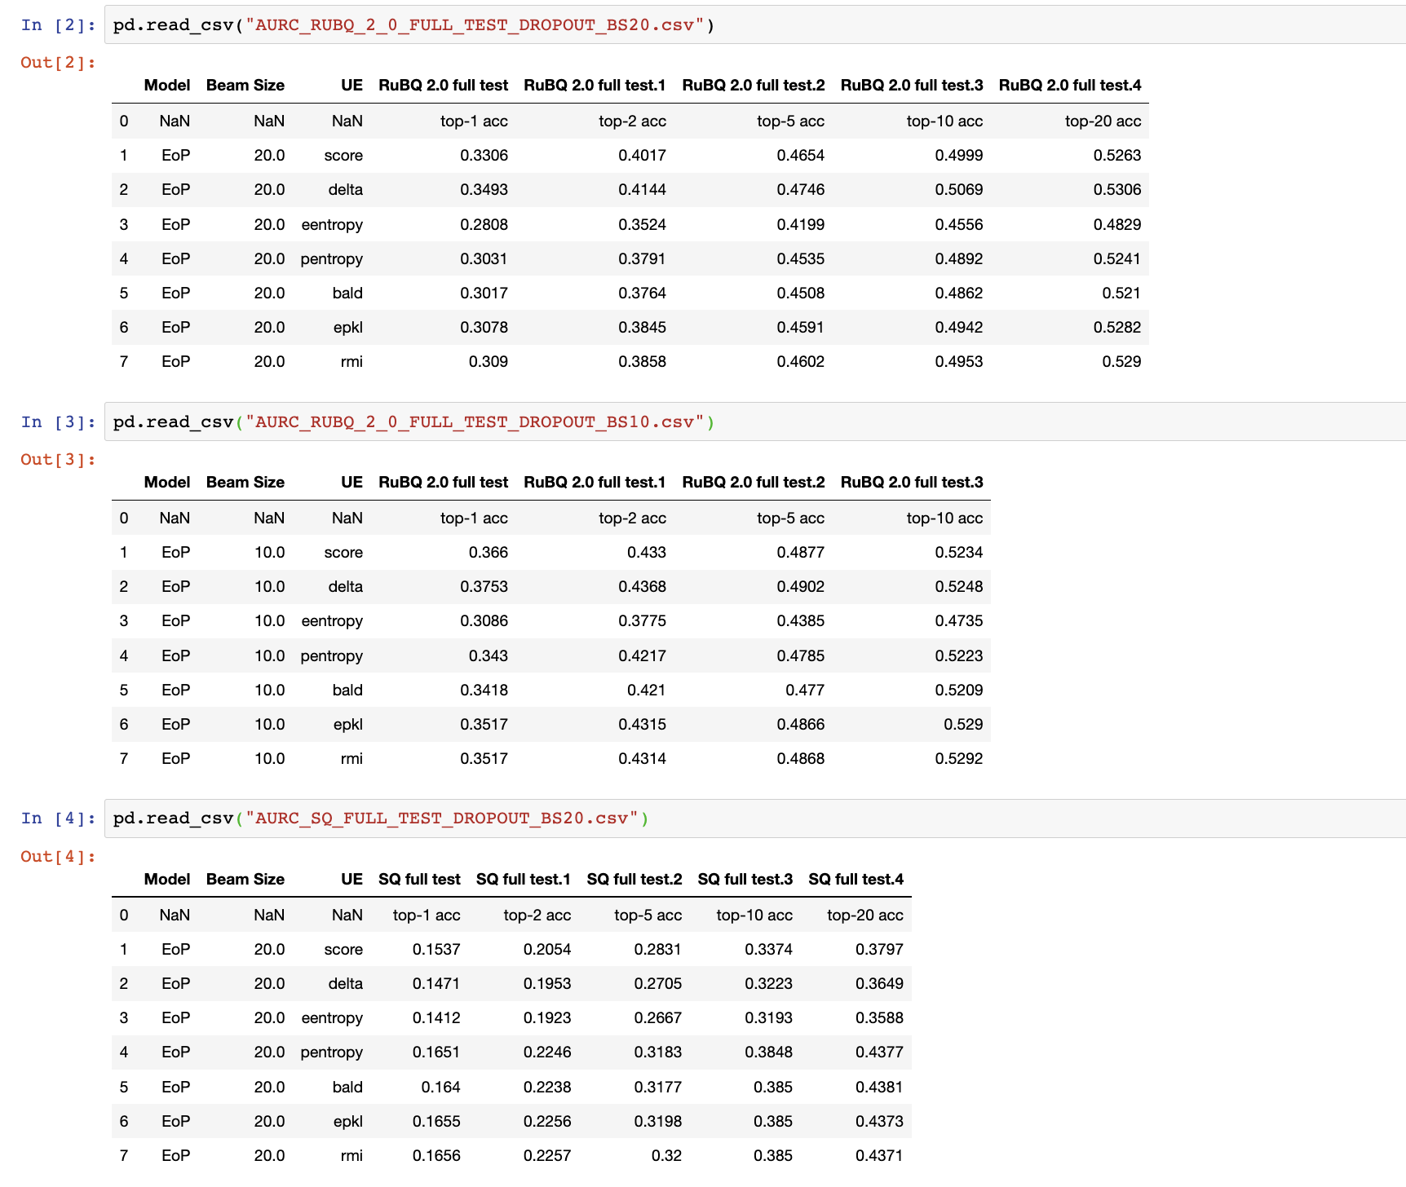

Slide 16
